Slide 1













MANIPAL
  ACADEMY OF HIGHER EDUCATION
  Institution of Embrace Diamant in the University
HackSprint
24-Hour Hackathon
17-18
VENUE DETAILS
Manipal Academy of Higher Education (MAHE)
SATURDAY
OCTOBER
09 A.M. Onwards
YOUR NAME: Bhavana B S & Meghana K S
TEAM NAME: Luxe Logic
TRACK NO: PS22 – AI Automation with n8n
REGISTER NOW
Team Size
1-4 Members
ORGANIZED BY:
MANIPAL
  ACADEMY OF HIGHER EDUCATION
  Institution of Embrace Diamant in the University
Notes:
Introduce the team (Luxe Logic) and the track: AI Automation with n8n, PS22.

Slide 2




Solution
Emergency Supply Fairness Engine: an autonomous coordination layer that decides how scarce supplies are shared across city wards every day during floods and heatwaves. It senses shortages, compares fair distribution plans, drafts dispatch orders and keeps an officer in control.
Sense
Compare
Act
Oversee
Reads ward stock, warehouse stock, road status and vulnerability reports from separate silos.
Scores need, road access and fairness debt, then builds two competing plans.
Drafts dispatch orders and triggers the delivery request once the plan is approved.
Officer receives a Fairness Report and approves or edits before anything moves.
Fairness Debt Tracking
Trade-offs made visible
Replayable evidence
Remembers wards that were underserved in earlier cycles and raises their priority next time.
Side-by-side plans show who gains and who loses under each policy. The officer chooses.
Every recommendation can be replayed from the saved inputs, rules and weights.
Carrier process: daily ward-level supply cycles in floods and heatwaves. The prototype runs on synthetic data.
Notes:
Use the thermostat analogy: sense, compare, act, with a human in the loop. Stress fairness debt and visible trade-offs.

Slide 3






Tech Stack & Architecture
Orchestration
Decision engine
AI layer
Built: n8n workflow with a manual trigger and four chained Code-node stages.
Built: n8n Code nodes compute need scores, road-aware routing, fairness debt and both plans. Fully deterministic.
Planned: an LLM in the n8n AI Agent node rewords the Fairness Report and reads free-text reports. It never sets the numbers.
Data layer
Interface
Reliability
Prototype: synthetic data inside the workflow. Planned: Google Sheets for wards, warehouses, roads and ledger.
Planned: Telegram bot sends the approval card with Approve Plan A, Approve Plan B and Edit buttons.
Built: rule version and audit fields in every output. Planned: replay view and an error workflow with retries.
Notes:
Key point: numbers come from deterministic Code nodes; the LLM only explains and reads free text.

Slide 4
System Architecture
1 Data layer
Ward and shelter stock
Warehouse stock
Road and transport status
Vulnerability reports
2 Orchestration (n8n)
Schedule trigger per cycle
Validate and clean data
Sub-workflow per stage
Error and retry workflow
3 Intelligence
Need score and road access
Fairness debt from ledger
Plan A need-based vs Plan B minimum-coverage
LLM: report parsing and Fairness Report
4 Action and oversight
Telegram approval card
Dispatch order via webhook or sheet
Ledger and audit log update
Replay view
Priority = need score × road access + λ × fairness debt − secondary-supply discount (weights are shown to the officer)
Notes:
Walk top to bottom. The formula is the heart of the fairness logic: debt raises priority for wards that were underserved before.

Slide 5
Data Flow Diagram
Officer
reviews and approves
Wards and shelters
stock, vulnerability reports
P1 Ingest and validate
P2 Score need and road access
P3 Apply fairness debt
P4 Build Plan A and Plan B
P5 Fairness Report and approval
P6 Dispatch and update
Warehouses
stock levels
Transport dept
road status
D1 Ward data
D2 Warehouse stock
D3 Road status
D4 Fairness ledger
D5 Audit log
Rectangles: external entities. Rounded boxes: processes. Shaded boxes: data stores. Scores and plans come from deterministic Code nodes; the LLM only explains.
Notes:
Trace one cycle: data enters P1, is scored in P2 and P3, two plans are built in P4, the officer approves in P5, then P6 dispatches and updates the ledger.

Slide 6
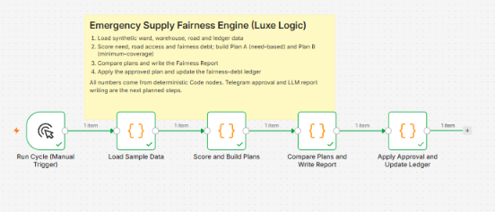
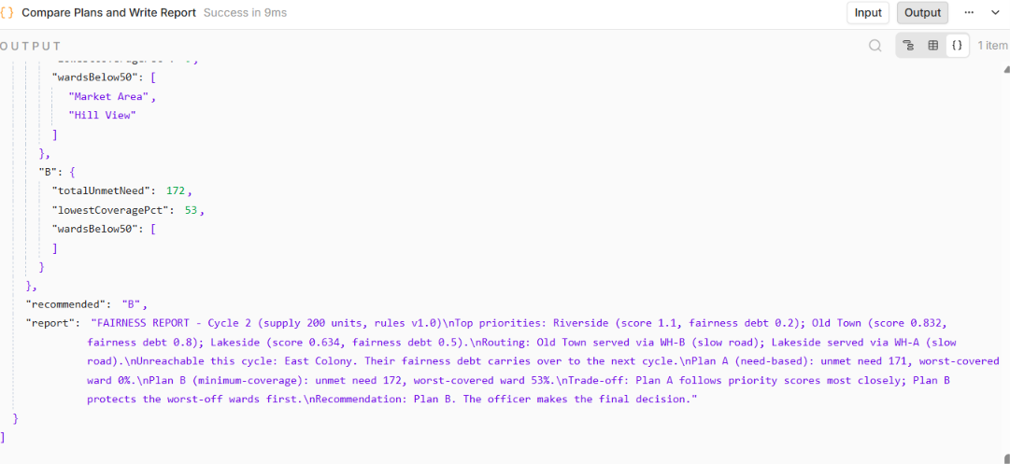
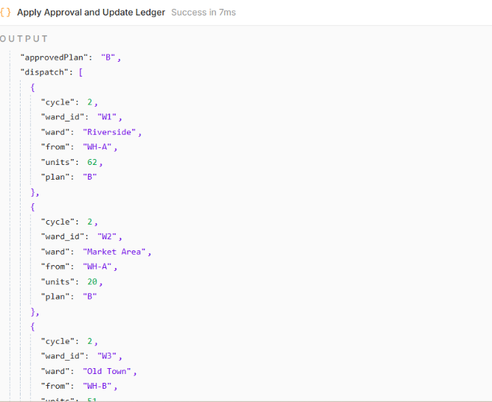
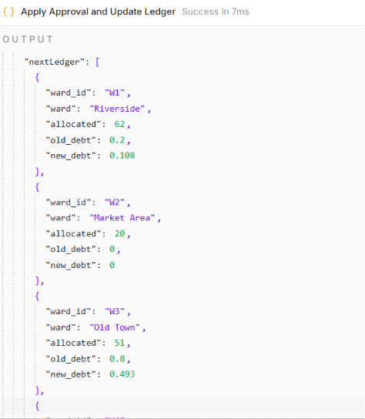
Screenshot of Your Project
n8n workflow: all five nodes ran successfully
Fairness Report with Plan A vs Plan B comparison
What the run shows
Plan B is recommended: the worst-covered ward gets 53% versus 0% under Plan A.
Old Town's fairness debt falls from 0.8 to 0.49 once it is served.
East Colony is unreachable, so its debt carries over to the next cycle.
Dispatch order (Plan B approved)
Updated fairness-debt ledger
Notes:
Screenshots are from the working n8n prototype running on synthetic data. Walk left to right: workflow, report, dispatch, ledger.

Slide 7
Others
Design goals for the prototype
Ethics and accountability
Plan generation in under a minute per cycle
Every recommendation replayable from saved inputs
No ward left underserved for three cycles in a row
Fairness is made visible and adjustable, not claimed
The officer picks the policy and approves every plan
Audit log, rule versions and replay for each decision
No personal identifiers in the data
Where else it applies
24-hour build plan
Water tanker allocation across wards
Ration and relief-camp supplies
Ambulance and shelter allocation
Vaccine and medicine distribution
Built: scoring, road-aware routing, Plan A and B, Fairness Report, ledger update
Next: Telegram approval, LLM report wording, Google Sheets, replay view
Out of scope: real sensors and live logistics APIs
GitHub repository: https://github.com/bhavanabs2006bs/luxe-logic-fairness-engine
Team Luxe Logic | Bhavana B S · Meghana K S | PS22 – AI Automation with n8n
Notes:
Be upfront: targets are design goals and data is synthetic. Emphasise the ethics slide: fairness is visible and adjustable.

